Slide 1
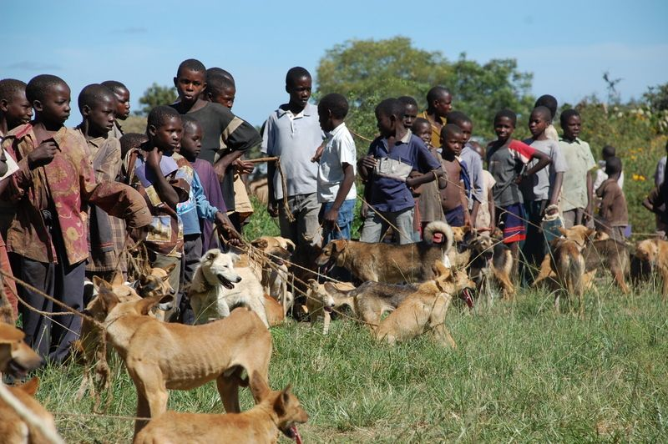
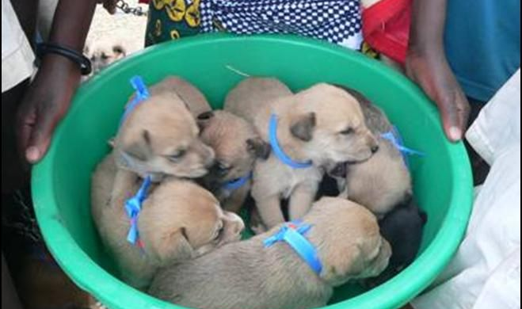
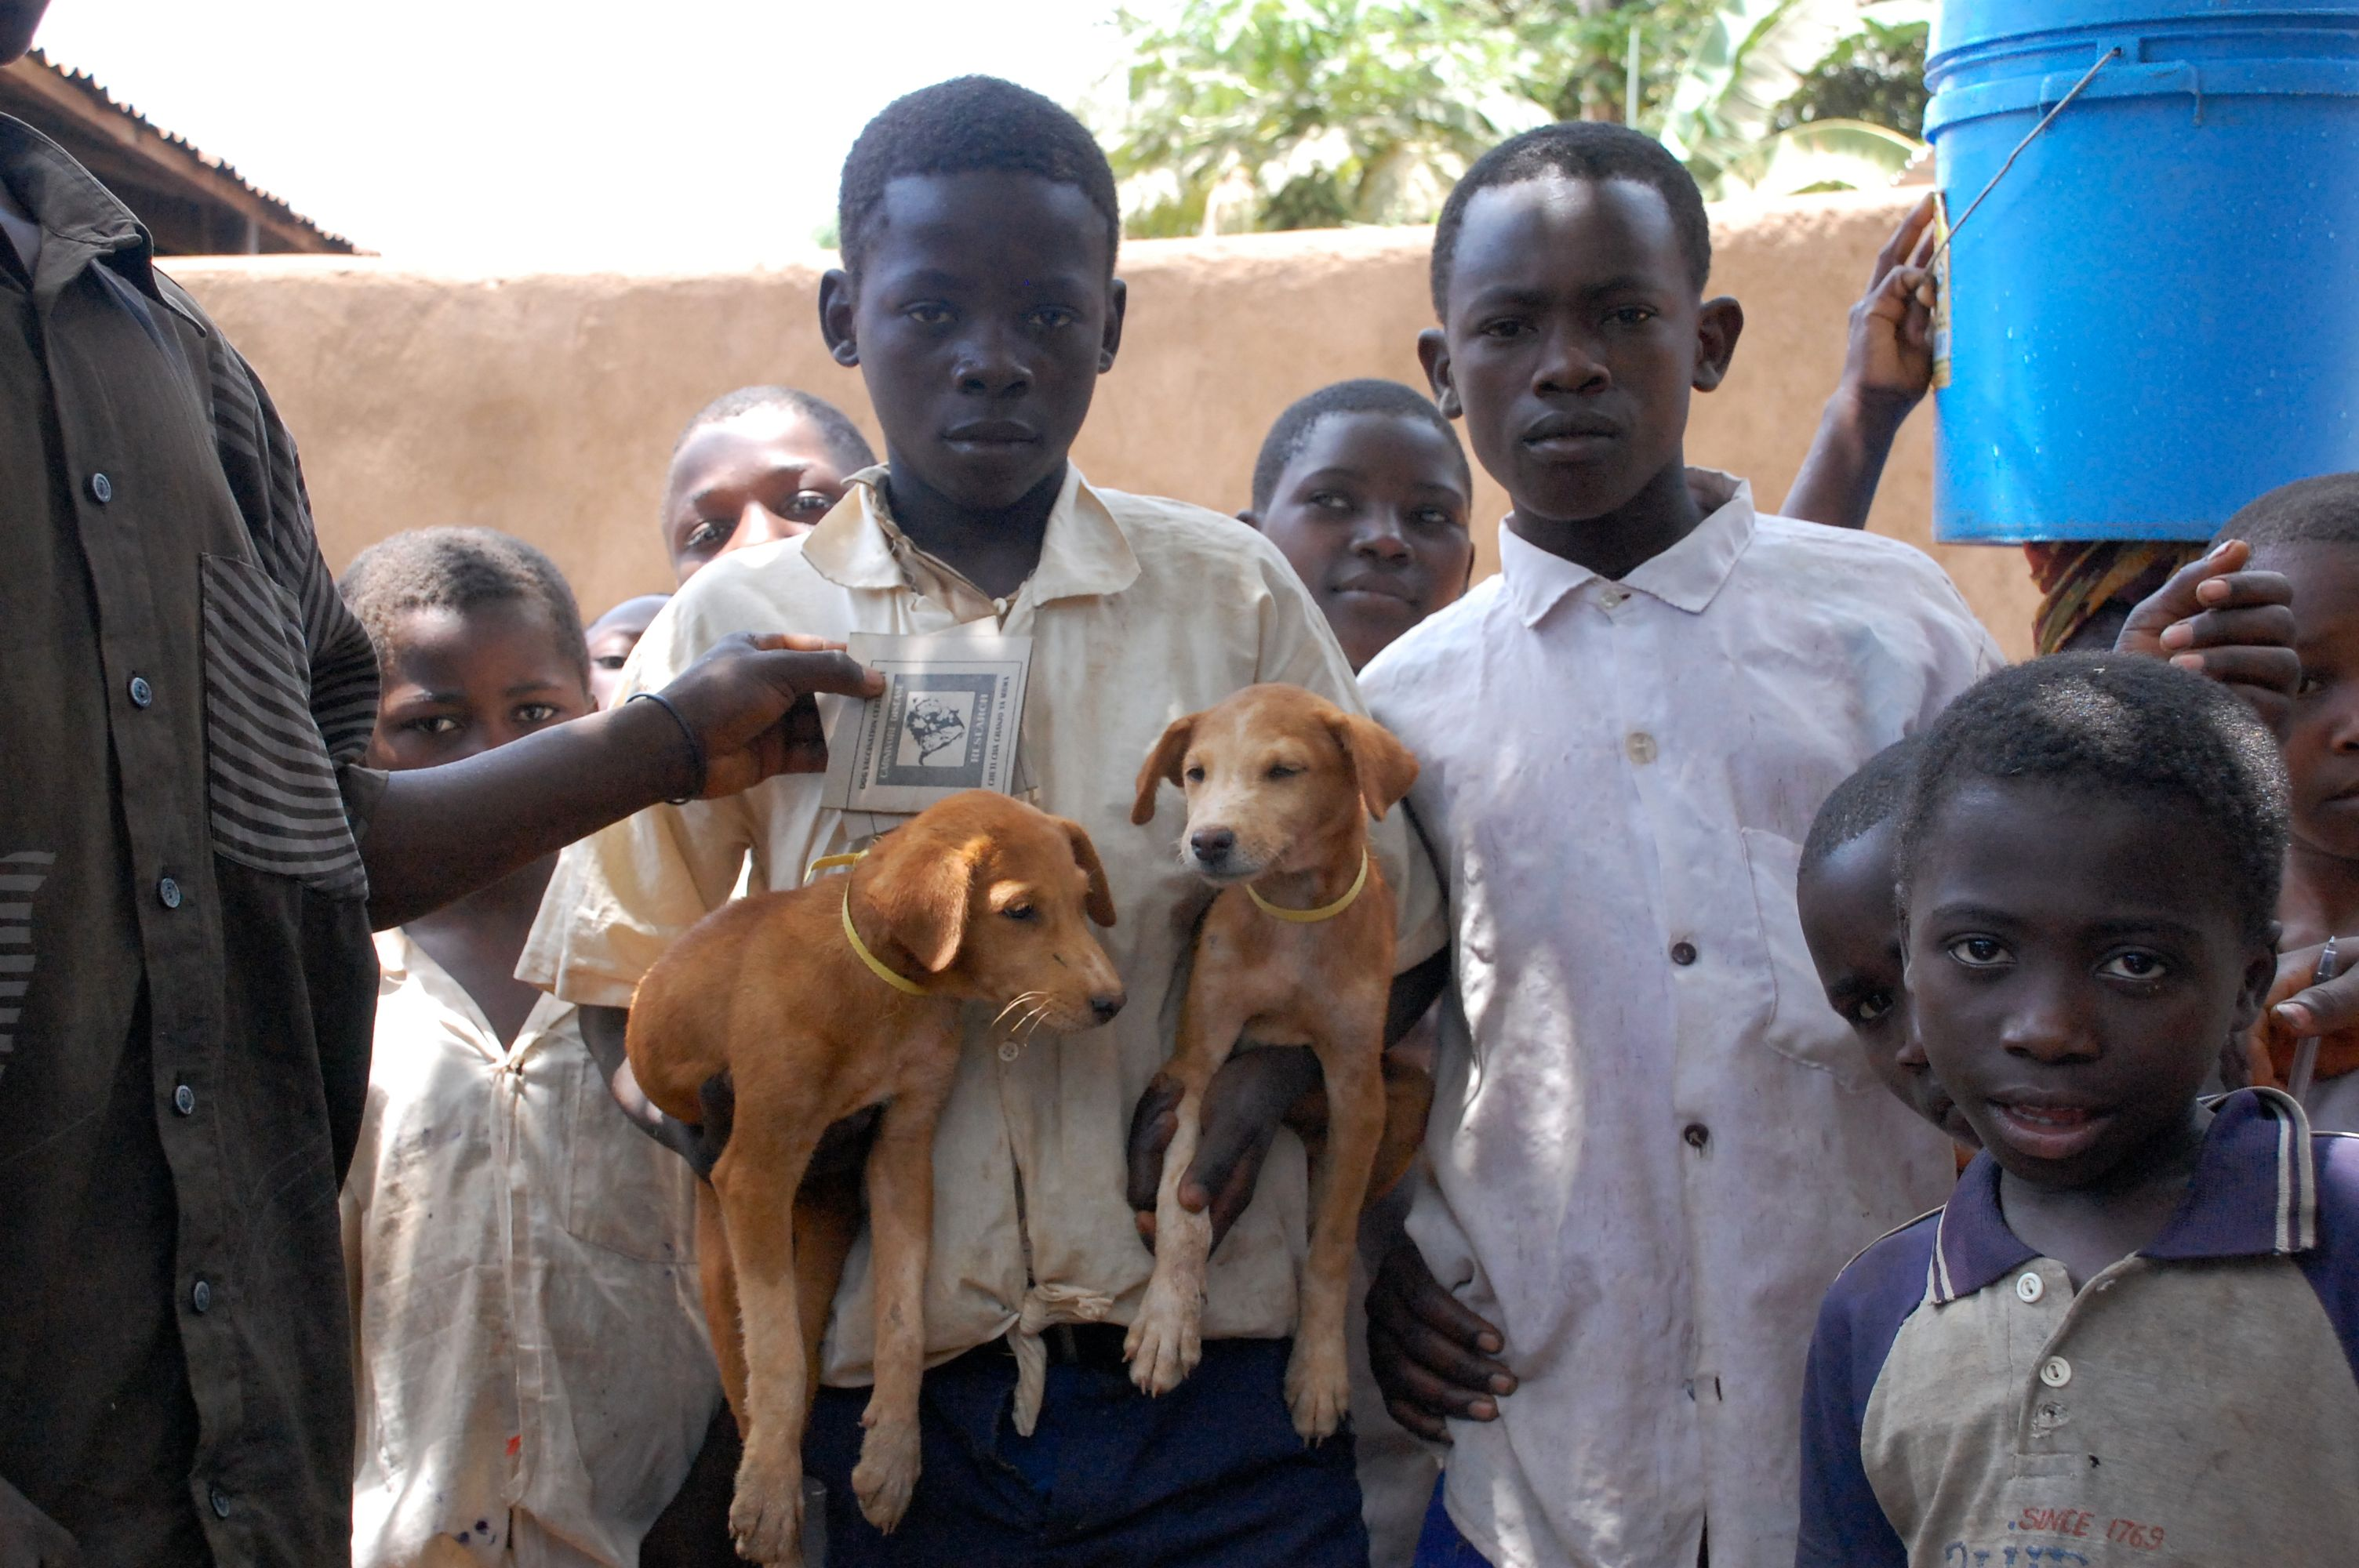


MADDOG: Updated Classifications for Genomic Surveillance of Rabies
Kathryn Campbell
Kathryn.Campbell@Glasgow.ac.uk
@ThatKatC

Slide 2
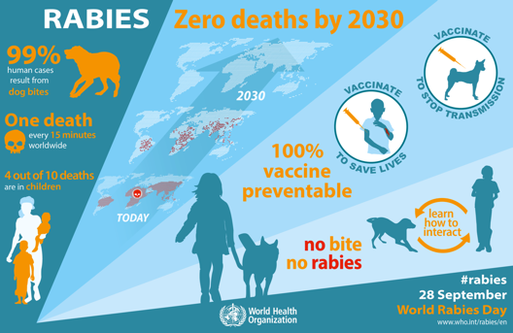
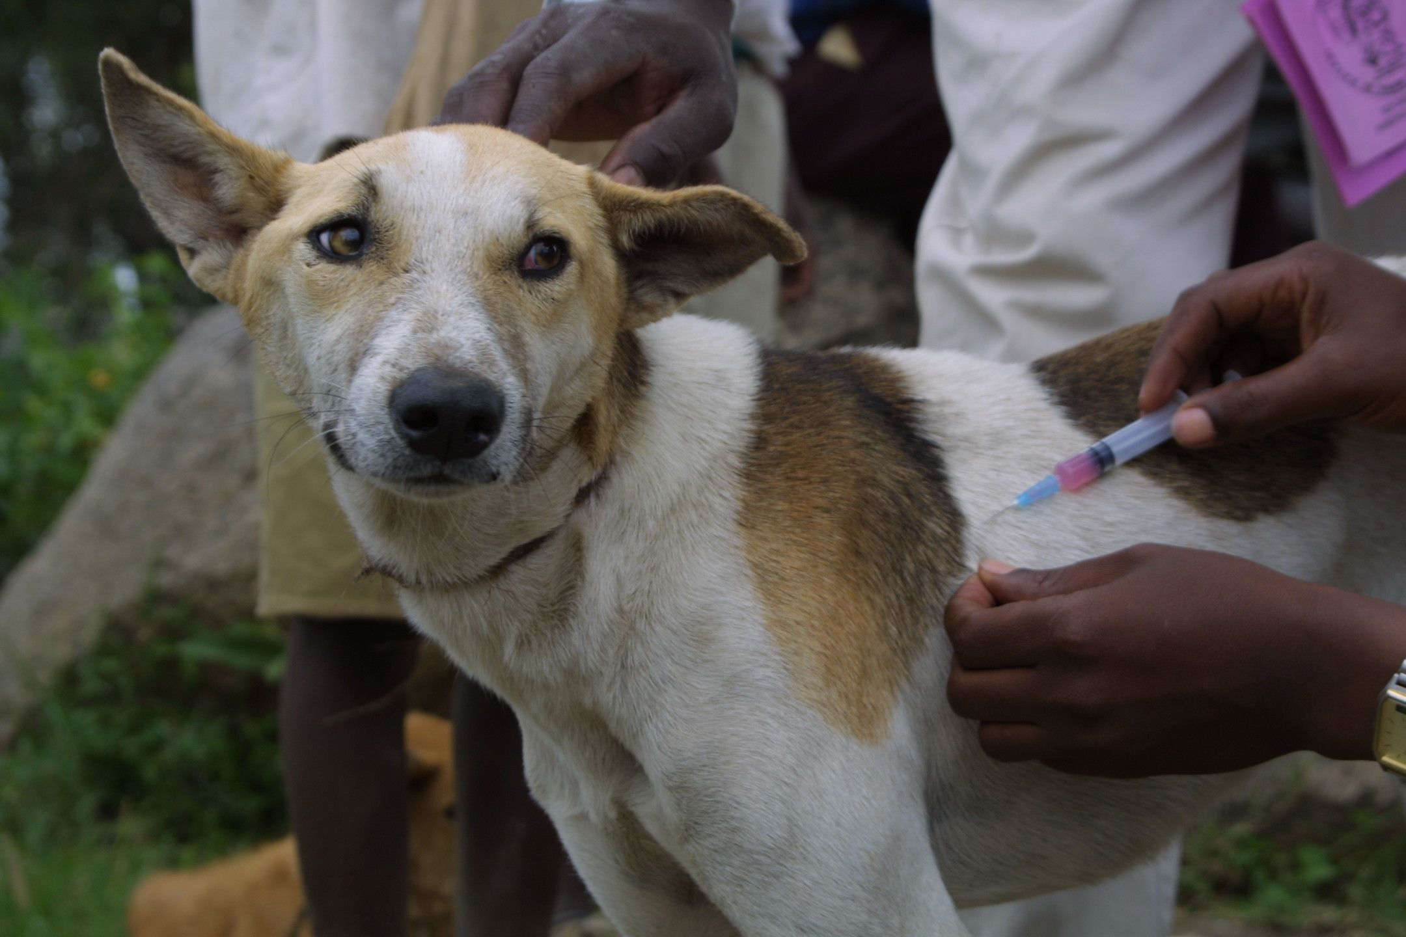
Rabies elimination “Zero by 30”
What is circulating?
Where is it coming from?
Why is it persisting?
How can we stop it?
Huge global collaboration
Implementation
Monitoring and evaluation
Policy updates
Notes:
59,000 per year
8.6 billion dollars
Single strand negative sense RNA virus from Lyssavirus genus
In 2019, Mexico became the first country to be validated by the World Health Organisation for eliminating human deaths from dog-mediated rabies

Slide 3
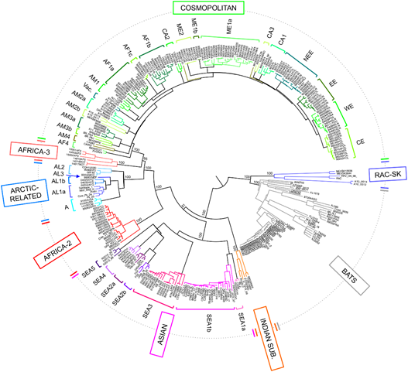
The global rabies phylogeny reveals large-scale geographic structure
2 major phylogenetic groups; bat related and dog related (5-7 clades)
Same geographical area group closely together
Host species also important but less so
Major clades are segregated by barriers
Oceans, mountain ranges, human factors
Troupin et. al (2016)
Notes:
Troupin 6 (figure)
Fischer 4
Africa 3 only mongoose
Box bats vs dogs

Slide 4
Greater phylogenetic resolution is needed to guide control programmes
Progress towards elimination, should see reduction in viral diversity
Need to see if any lineages have become extinct, or if any are persisting
Use this to direct elimination efforts
Monitor how we are progressing towards elimination
Needs a high-definition classification system
Current system is very broad – often only 1 subclade circulating
Can’t track changes
Needs to be universal
Lots of studies, but all define and name lineages differently
Can’t compare and communicate these
BUT
Need one, high definition system to classify all rabies globally

Slide 5
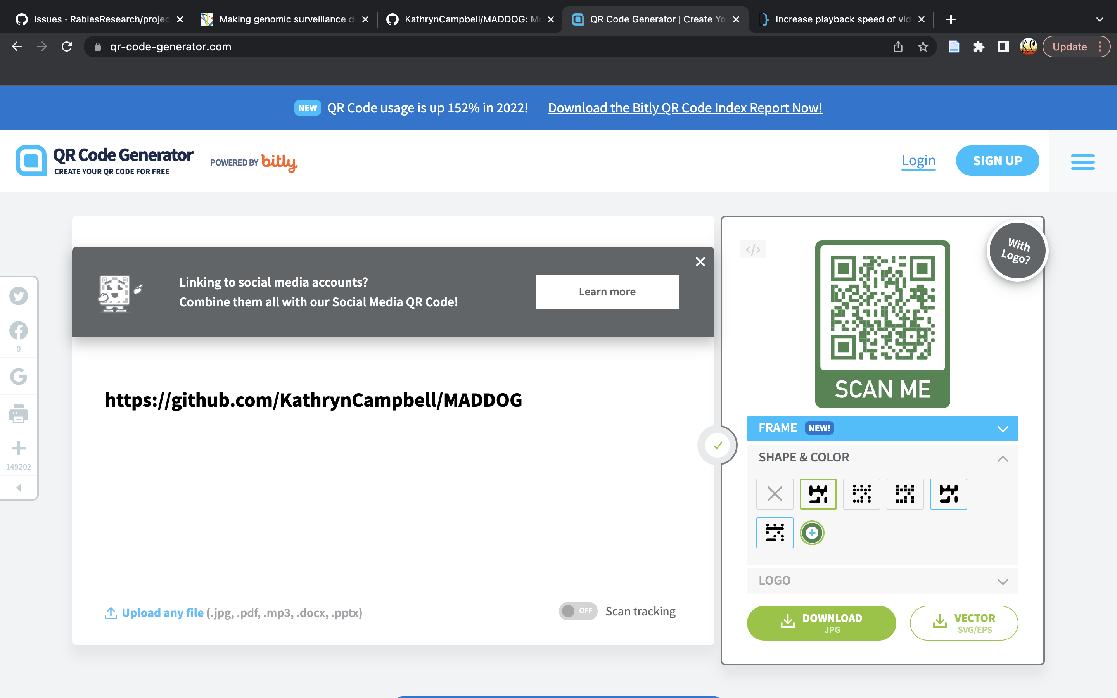
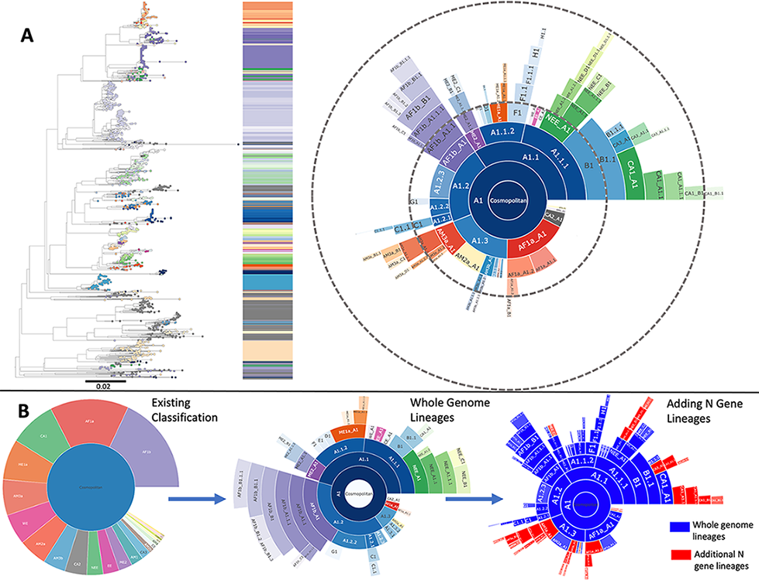
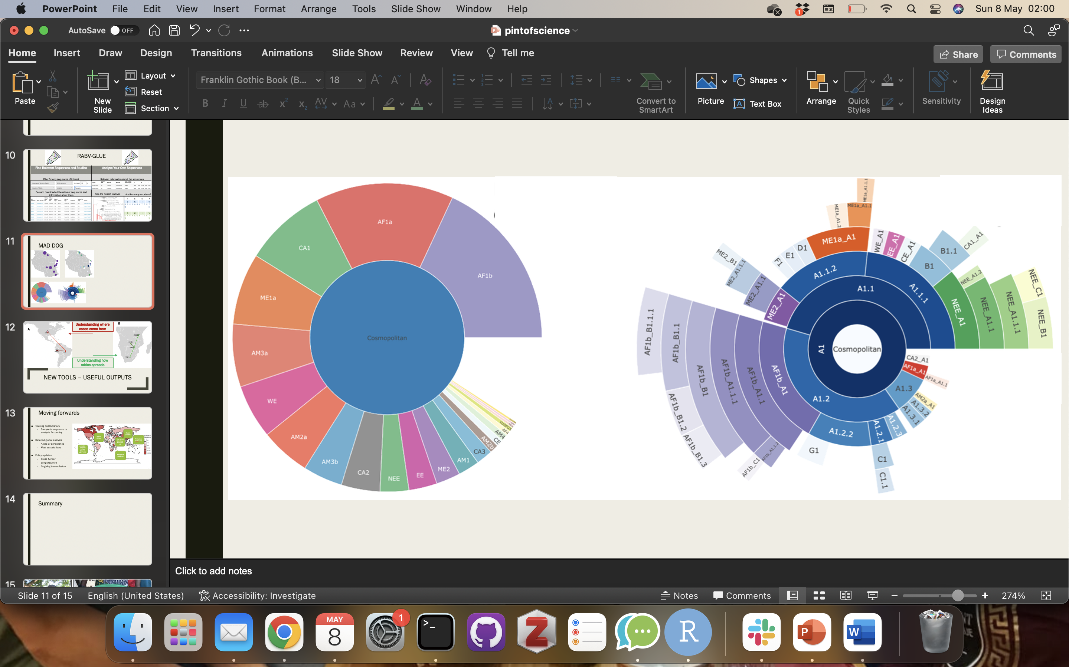
MAD DOG
Increase the resolution
See the patterns
Stop the Spread
Method for Assignment, Definition and Designation Of Global Lineages
Phylogeny based classification tool
Command line and R package
Over 4 fold increase in resolution
Does the analysis for you!
Campbell et al. 2022, PLoS Pathogens

Slide 6
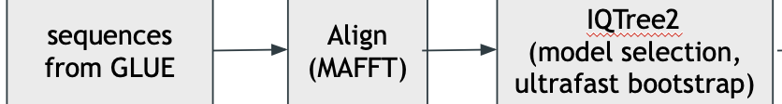
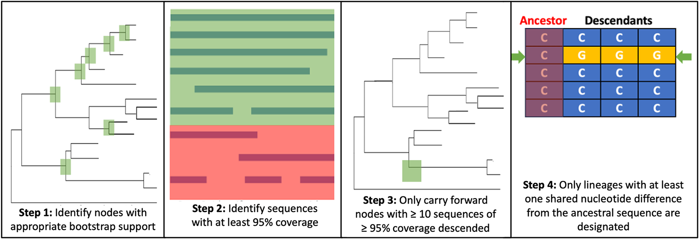
MAD DOG
Increase the resolution
See the patterns
Stop the Spread
Method for Assignment, Definition and Designation Of Global Lineages
METHODS
Modelled after SARS-CoV-2 lineage designation
Different parameters to consider for rabies!
Time scale
Existing classifications
Tracked since emergence vs decades of endemic circulation
Data Processing
Lineage Designation
Campbell et al. 2022, PLoS Pathogens

Slide 7
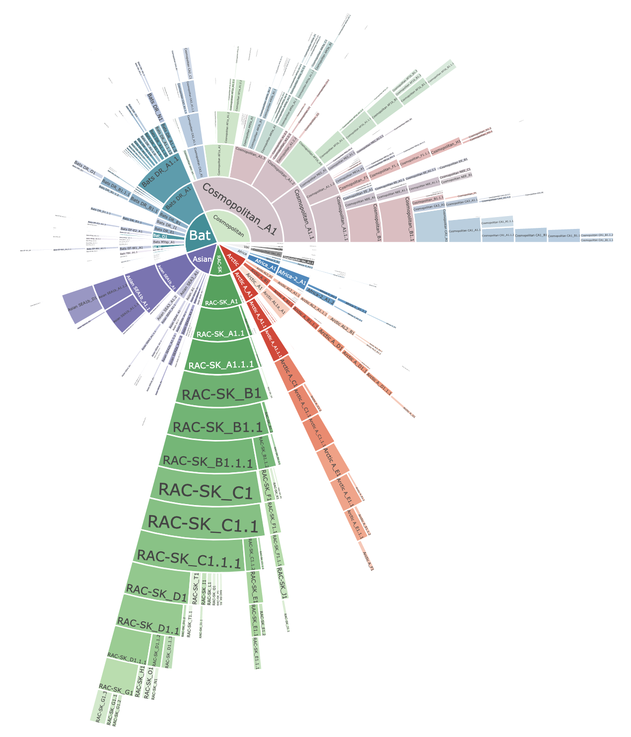
MAD DOG- Partial Genomes
650 WGS, 46 countries from 1950–2018
additional 1958 sequences, additional 25 countries from 1939–2019
22 subclades
52 lineages
96 lineages
All RABV clades
-
355 lineages

Slide 8
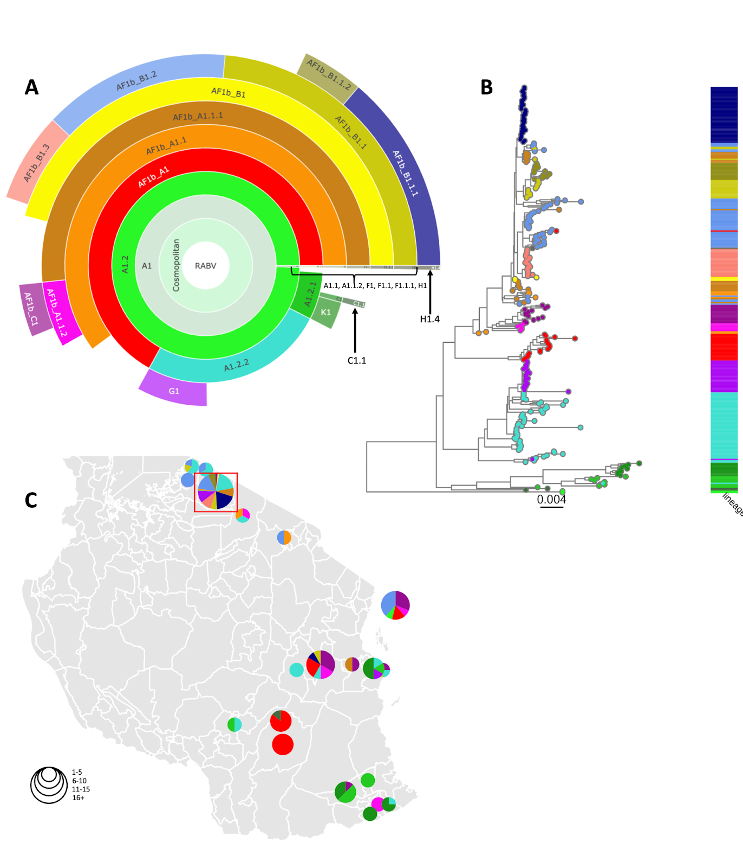
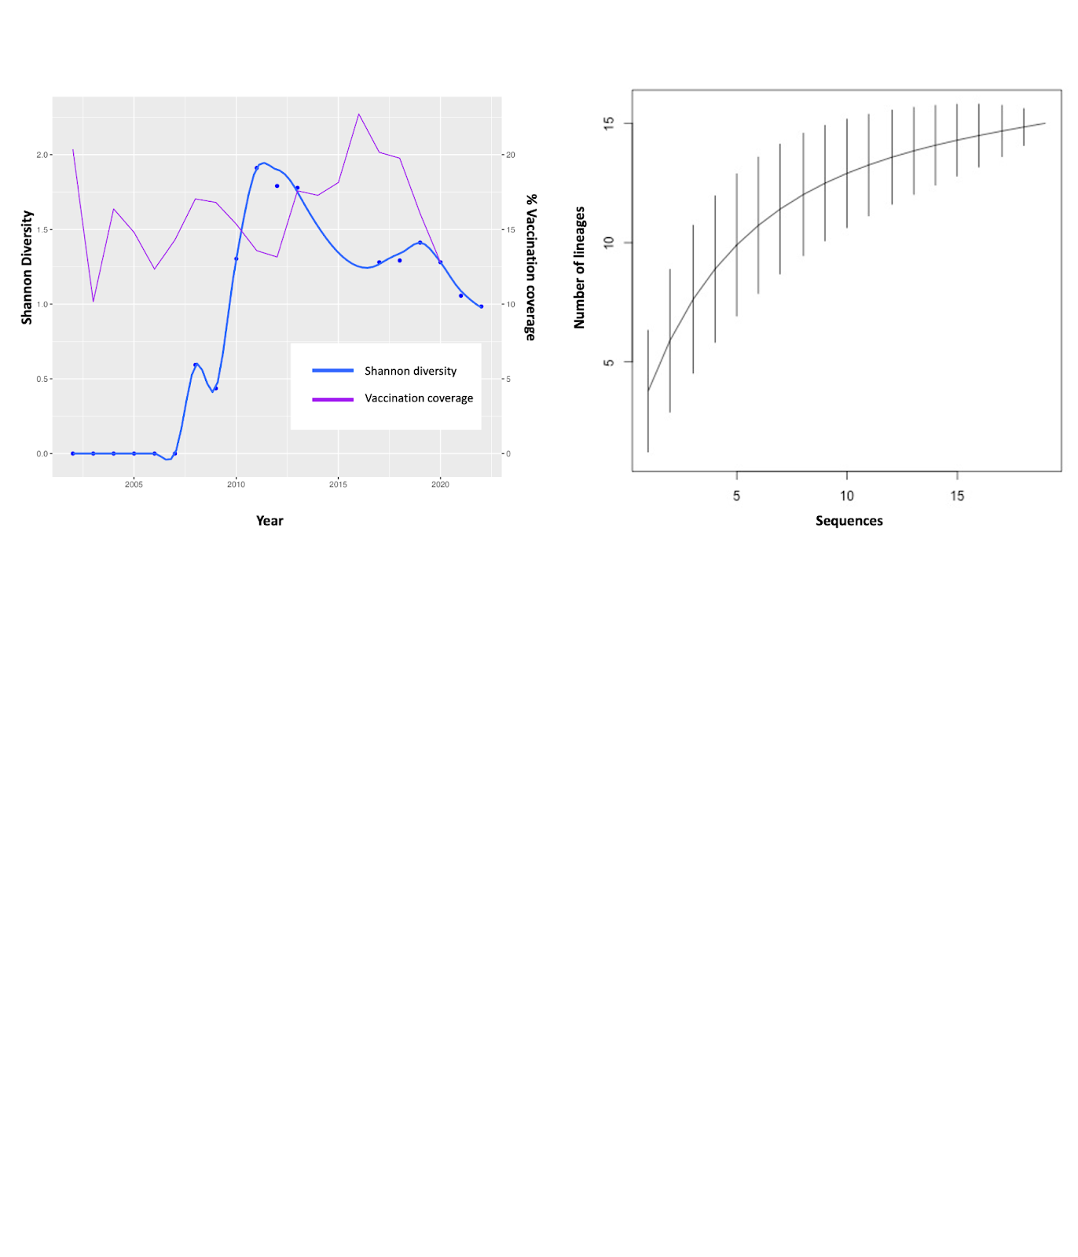
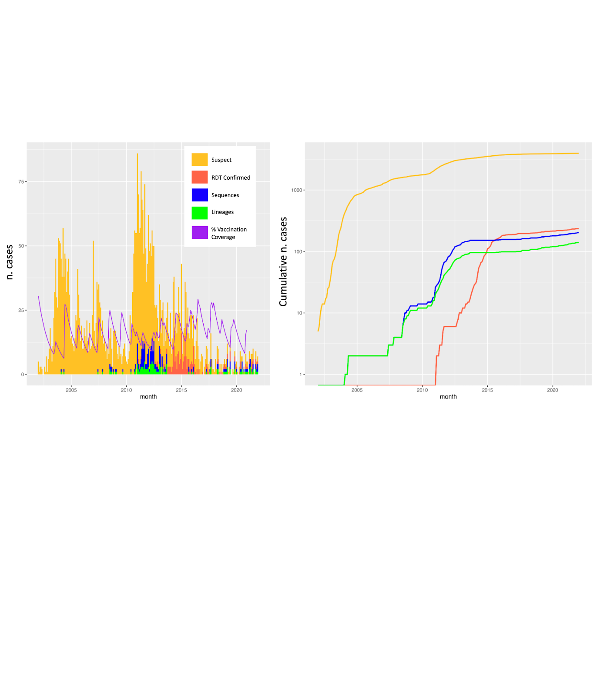
Increase the resolution
See the patterns
Stop the Spread

Slide 9
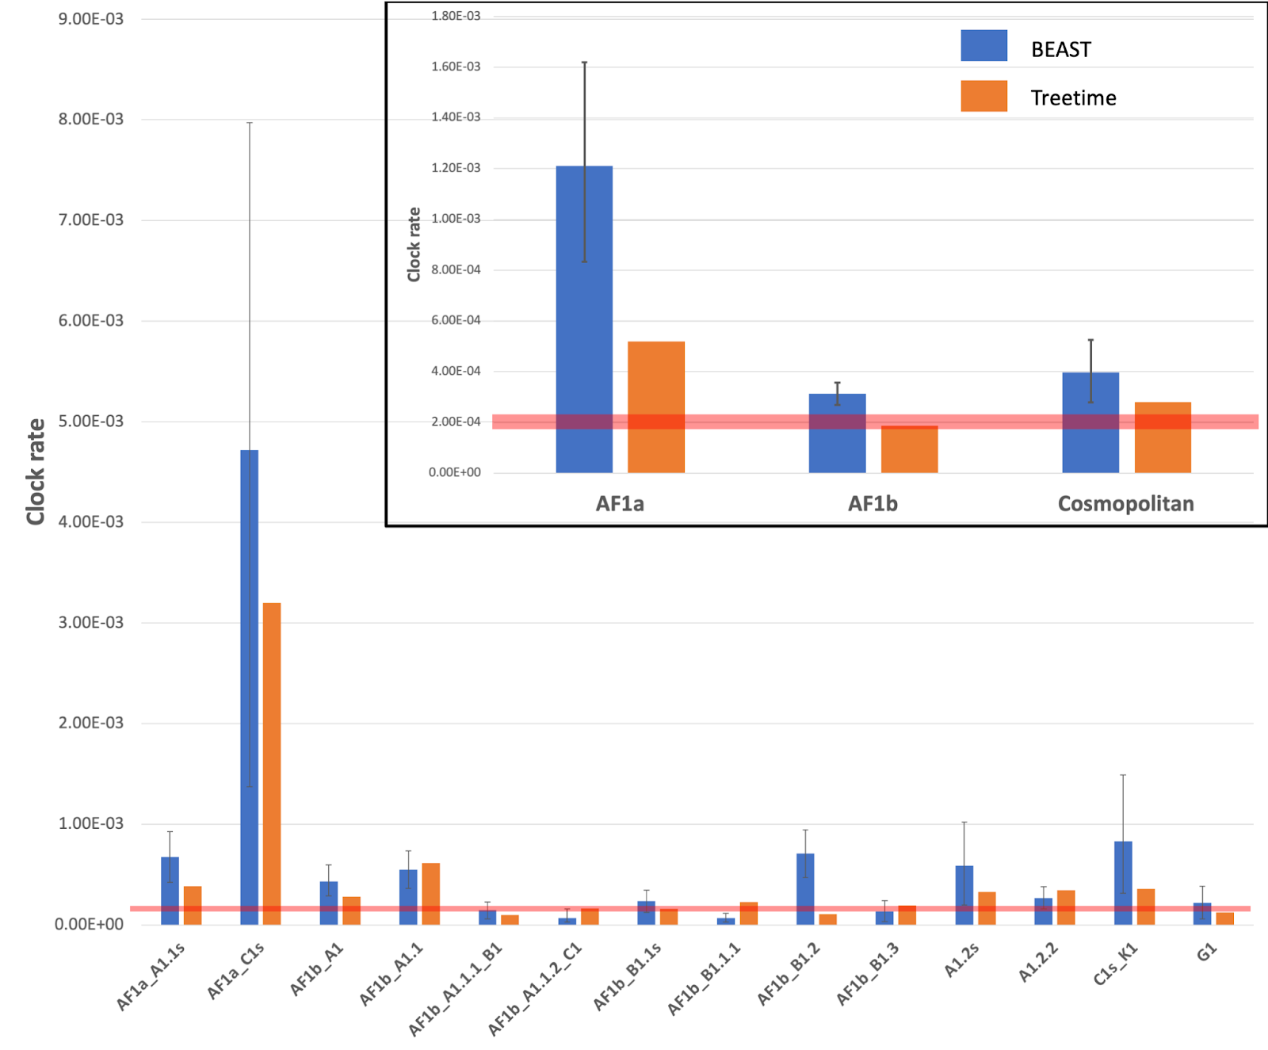
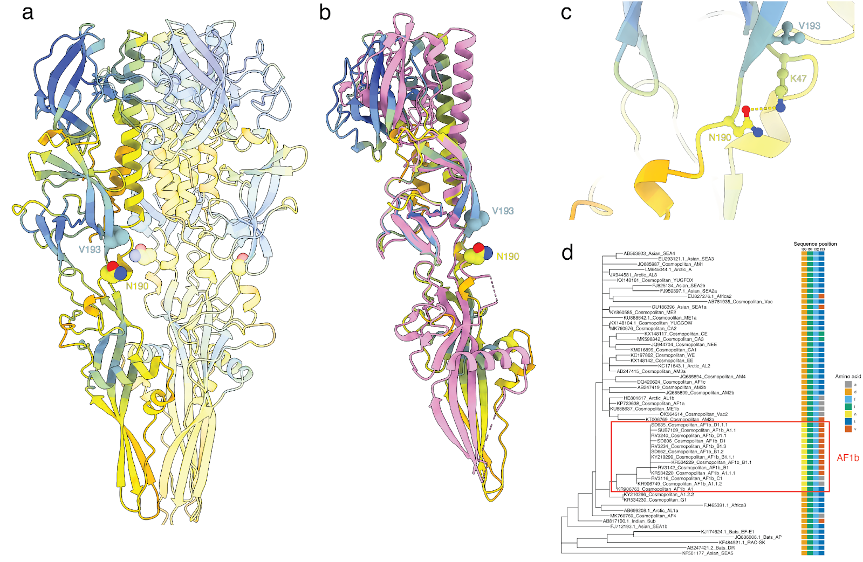
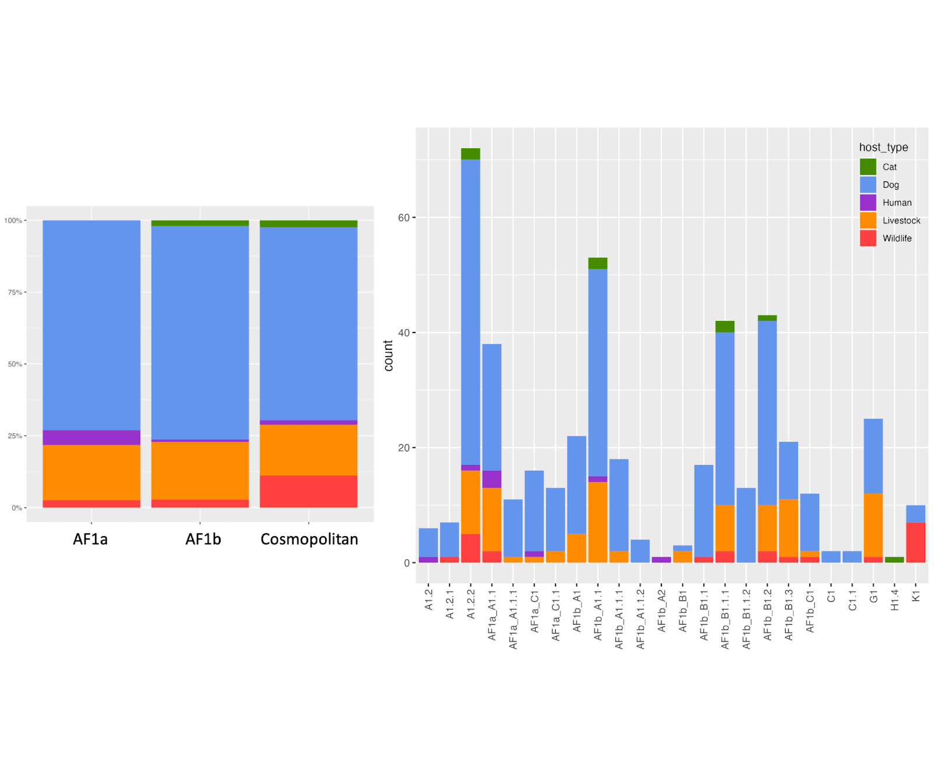
Identifying differences between lineages

Slide 10
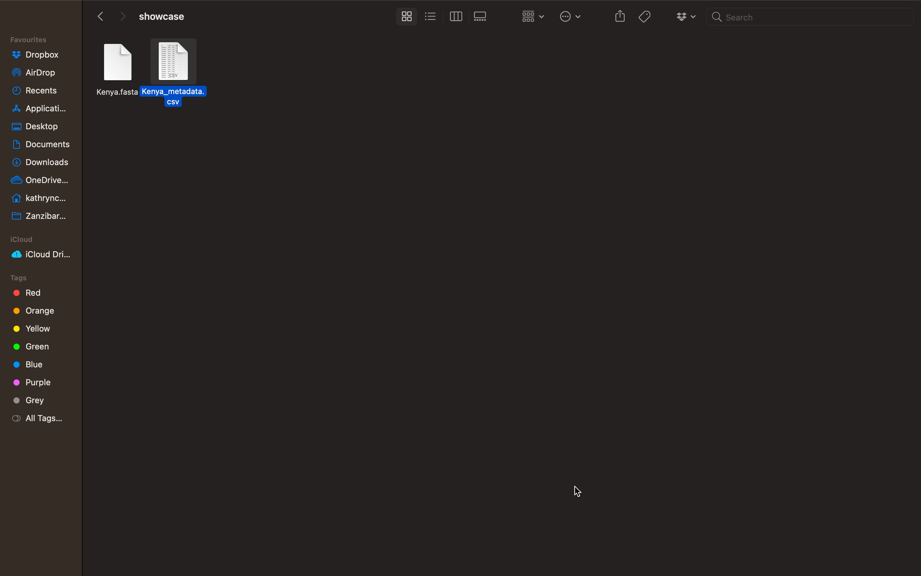

Slide 11
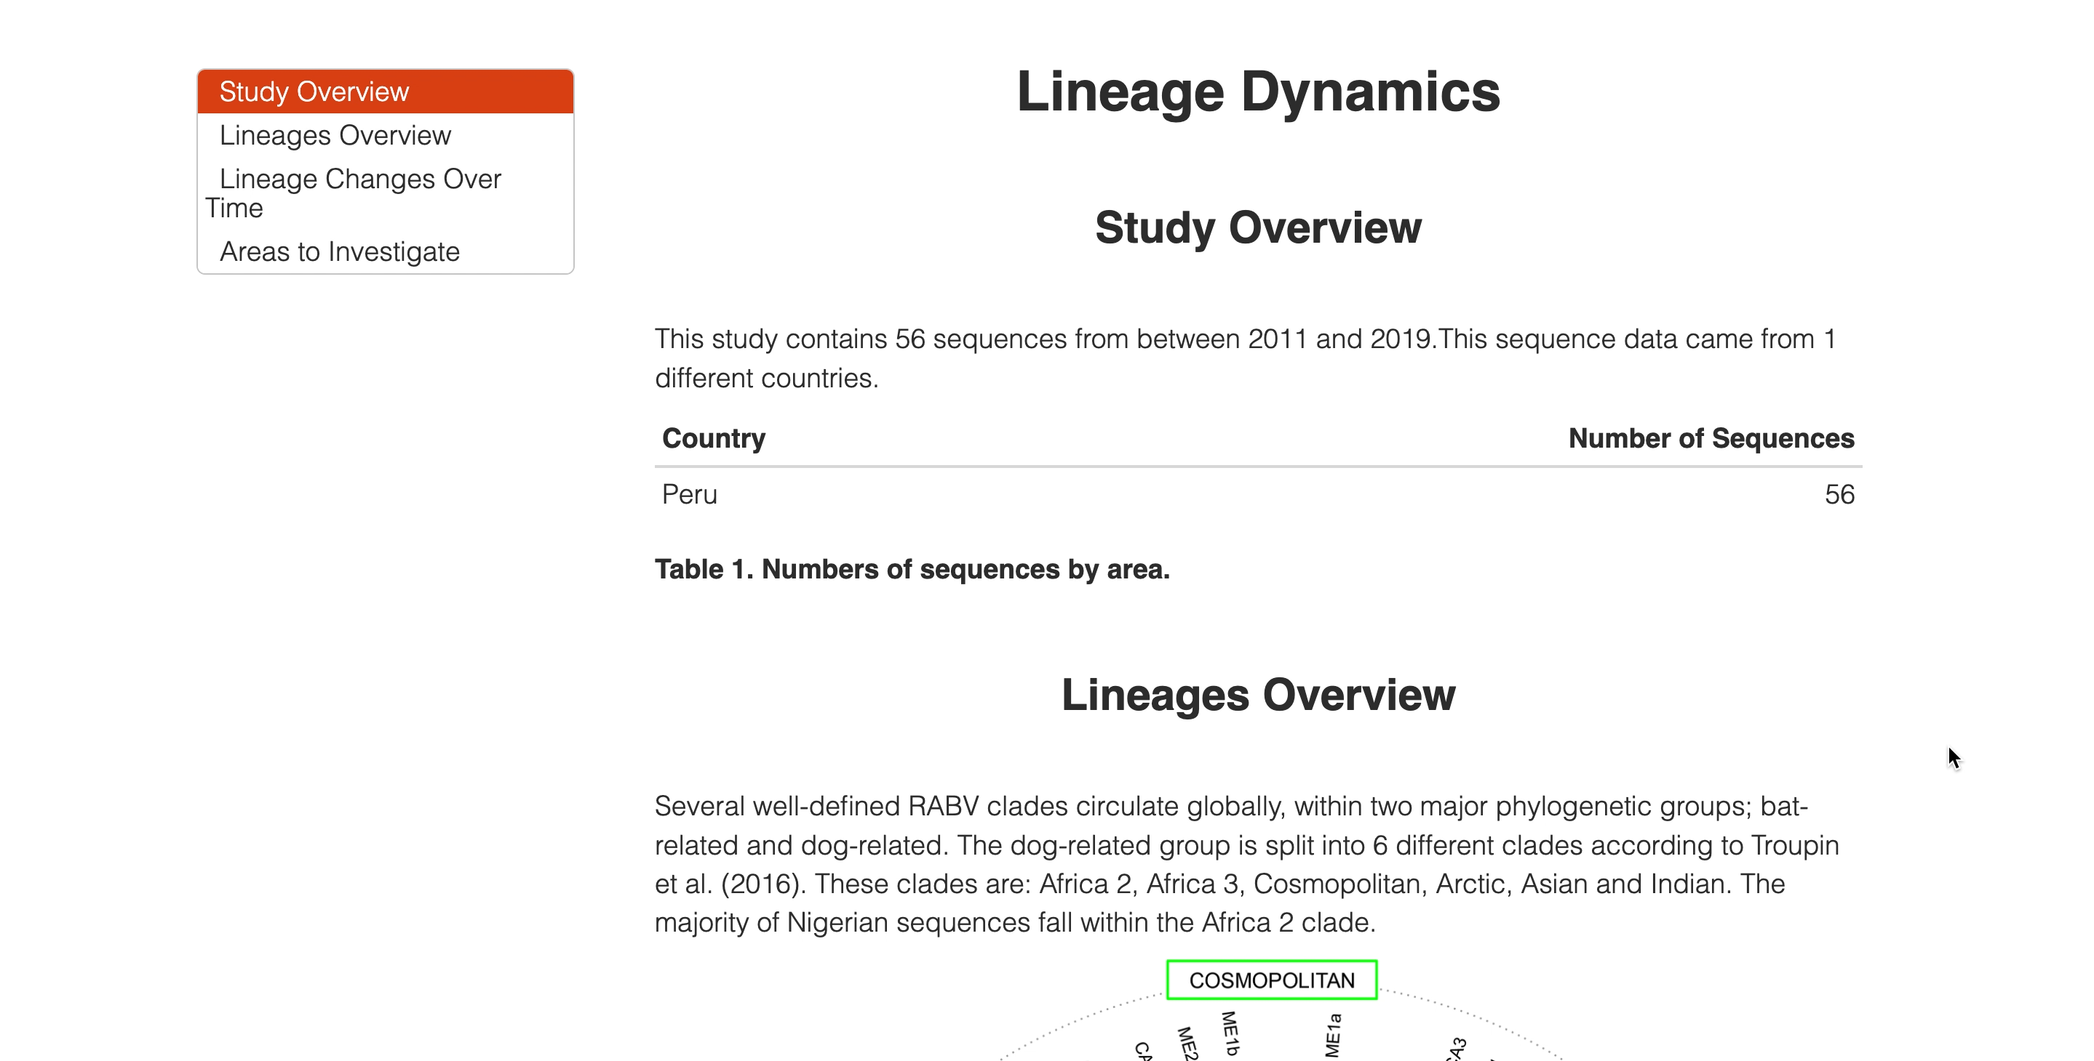

Slide 12
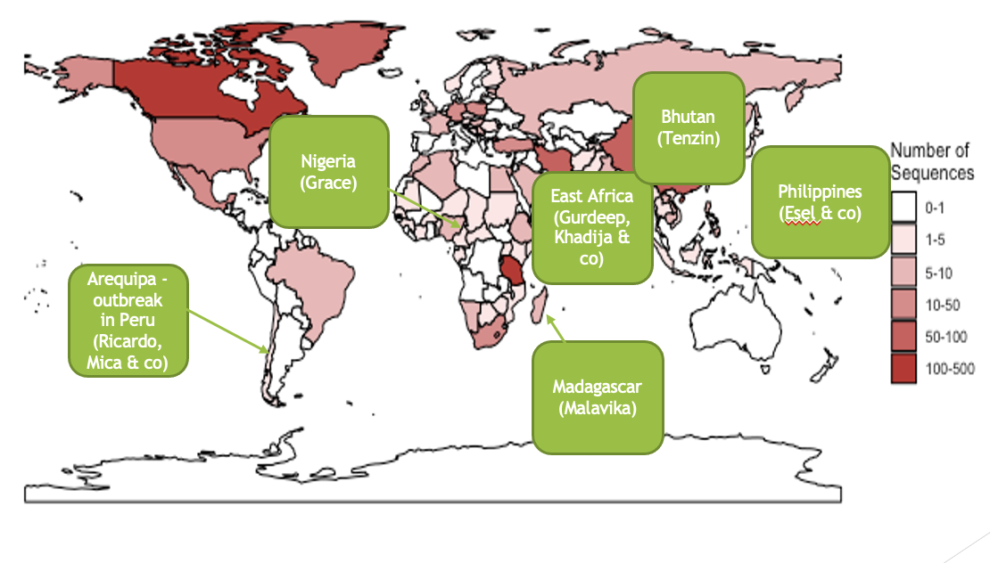
Moving forwards
Detailed global analysis
Areas of persistence
Host associations
Lineage specific differences
Evolutionary analysis
Amino acid substitutions
Impact
(Essel)

Slide 13



Acknowledgements
Katie Hampson
Kirstyn Brunker
Rob Gifford
Roman Biek
Rowan Durrant
Matt Arnold
Andrew Rambaut
Aine O’Toole
Verity Hill
Gurdeep Jaswant
Criselda Bautista

Slide 14
